Slide 1
Thermo Mechanical Modeling of Continuous Casting with Artificial Neural Network
Tadej Kodelja
COBIK, Solkan, Slovenia
Supervisor
Prof.dr. B Šarler

Slide 2
Scope
Continuous casting of steel and its physics
Approximative numerical models based on artificial neural network (ANN)
Modelling of continuous casting of steel by ANN
Conclusions and future work

Slide 3
Goals
Introduction to steel process modelling
Introduction and motivation for ANN modelling
Assessment of physical and ANN modelling of continuous casting of steel

Slide 4
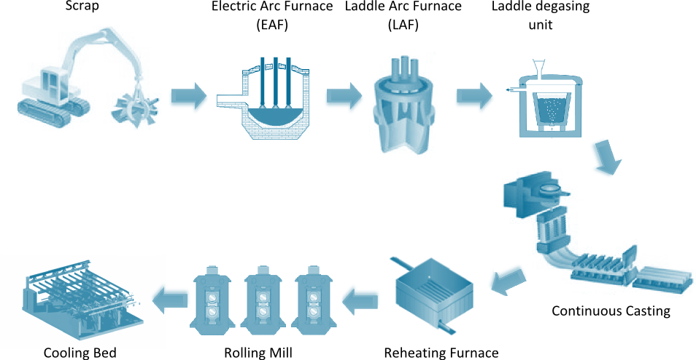
Steel Production Process Path

Slide 5
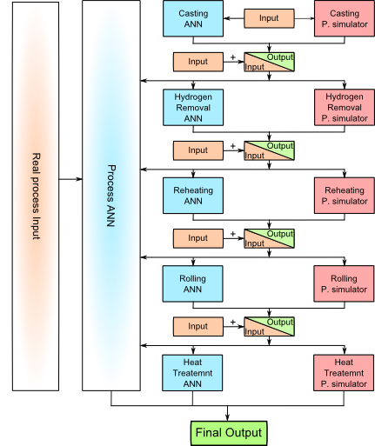
Steel Production Simulation Scheme
Final Measured Material Properties
Elongation (A)
Tensile strength (Rm)
Yield stress (Rp)
Hardness after rolling (HB)
Necking (Z)

Slide 6
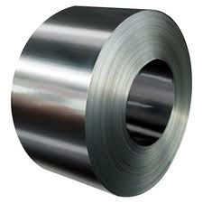
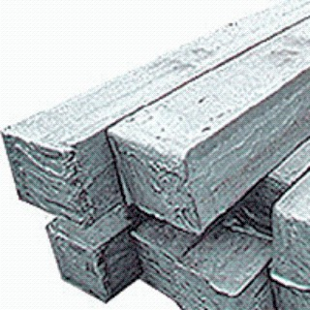
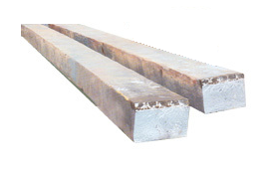
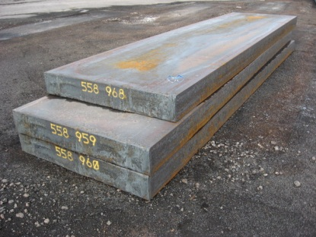
Continuous Casting of Steel
Process was developed in the 1950s
The most common process for production of steel
90% of all steel grades are produced by this technique
Types
Vertical, horizontal, curved, strip casting
Typical products
Billets, blooms, slab, strip

Slide 7
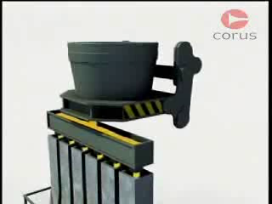
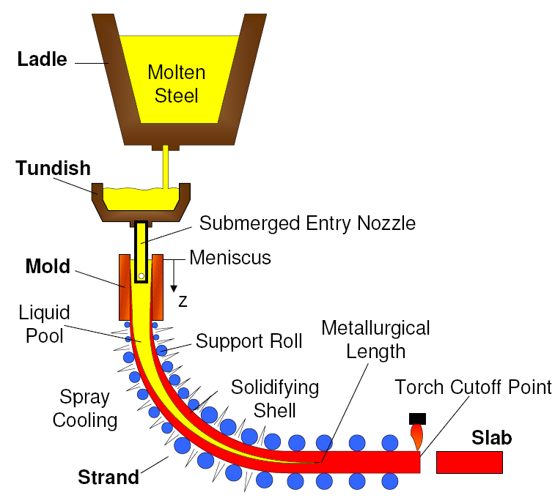
Continuous Casting of Steel

Slide 8
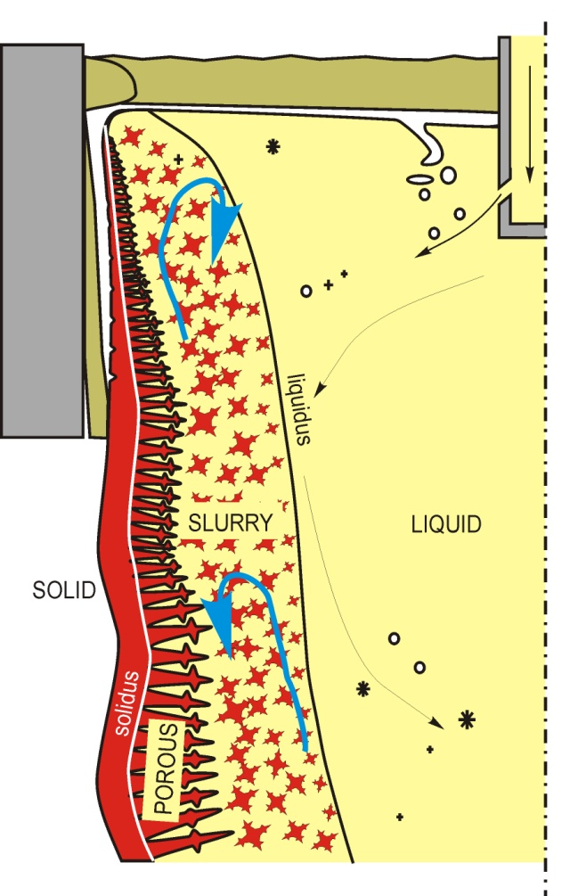
Characteristic Regimes in a Solidifying Continuous Casting
Regimes
LIQUID (liquid, particles, inclusions,…)
SLURRY (equiaxed dendrites + liquid)
POROUS (columnar dendrites + liquid)
SOLID (dendrites)

Slide 9
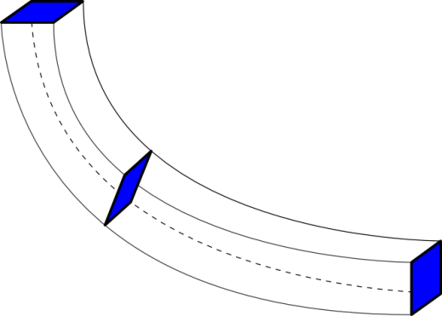
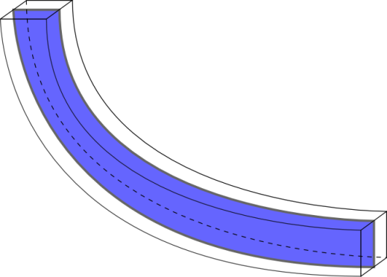
Numerical models of the Continuous Casting
Thermal models
Describes heat transfer with solidification
Casting velocity is constant for all phases
Using slice model
Fluid models
Turbulent fluid flow on a fixed geometry
Modeling of the turbulent flow involves solving additional two transport equations
Thermo-fluid models
Involves the solution of the fluid flow with the heat transfer, solidification and species transport
Much more complex to numerically implement

Slide 10
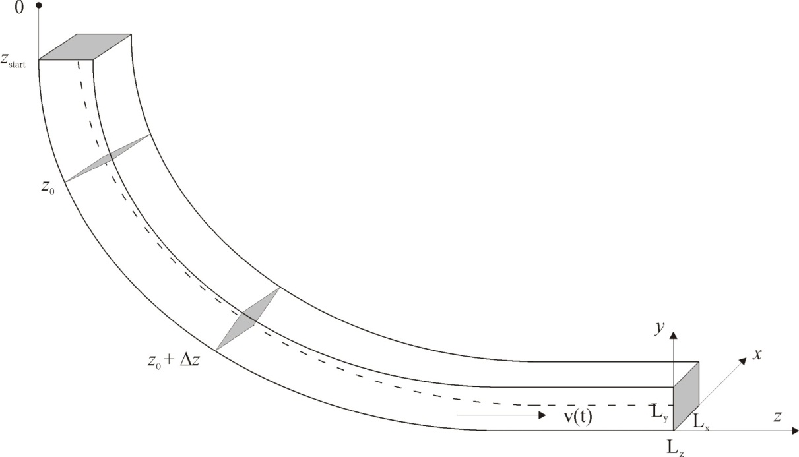
Slice Model
Slice traveling schematics in the billet
Fast calculation time
x-y cross sectional slide is moving from top horizontal to bottom vertical position
Temperature and boundary condition are assumed as time dependent
Notes:
Temperature and boundary conditions are assumed as time dependant based on constant speed and position of the slice

Slide 11
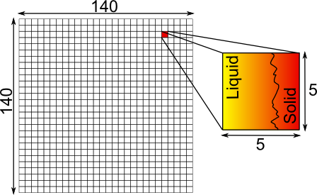
Macroscopic Transport Model
Governing equations
Enthalpy transport
Mixture and phase enthalpies
Solved based on initial and boundary conditions that relate the enthalpy transport with the process parameters
28 x 28 points
Notes:
The boundary temperature of the slice is defined by Heat tansfer coefficient and temperature of cooling fluid
The energy ballance is

Slide 12
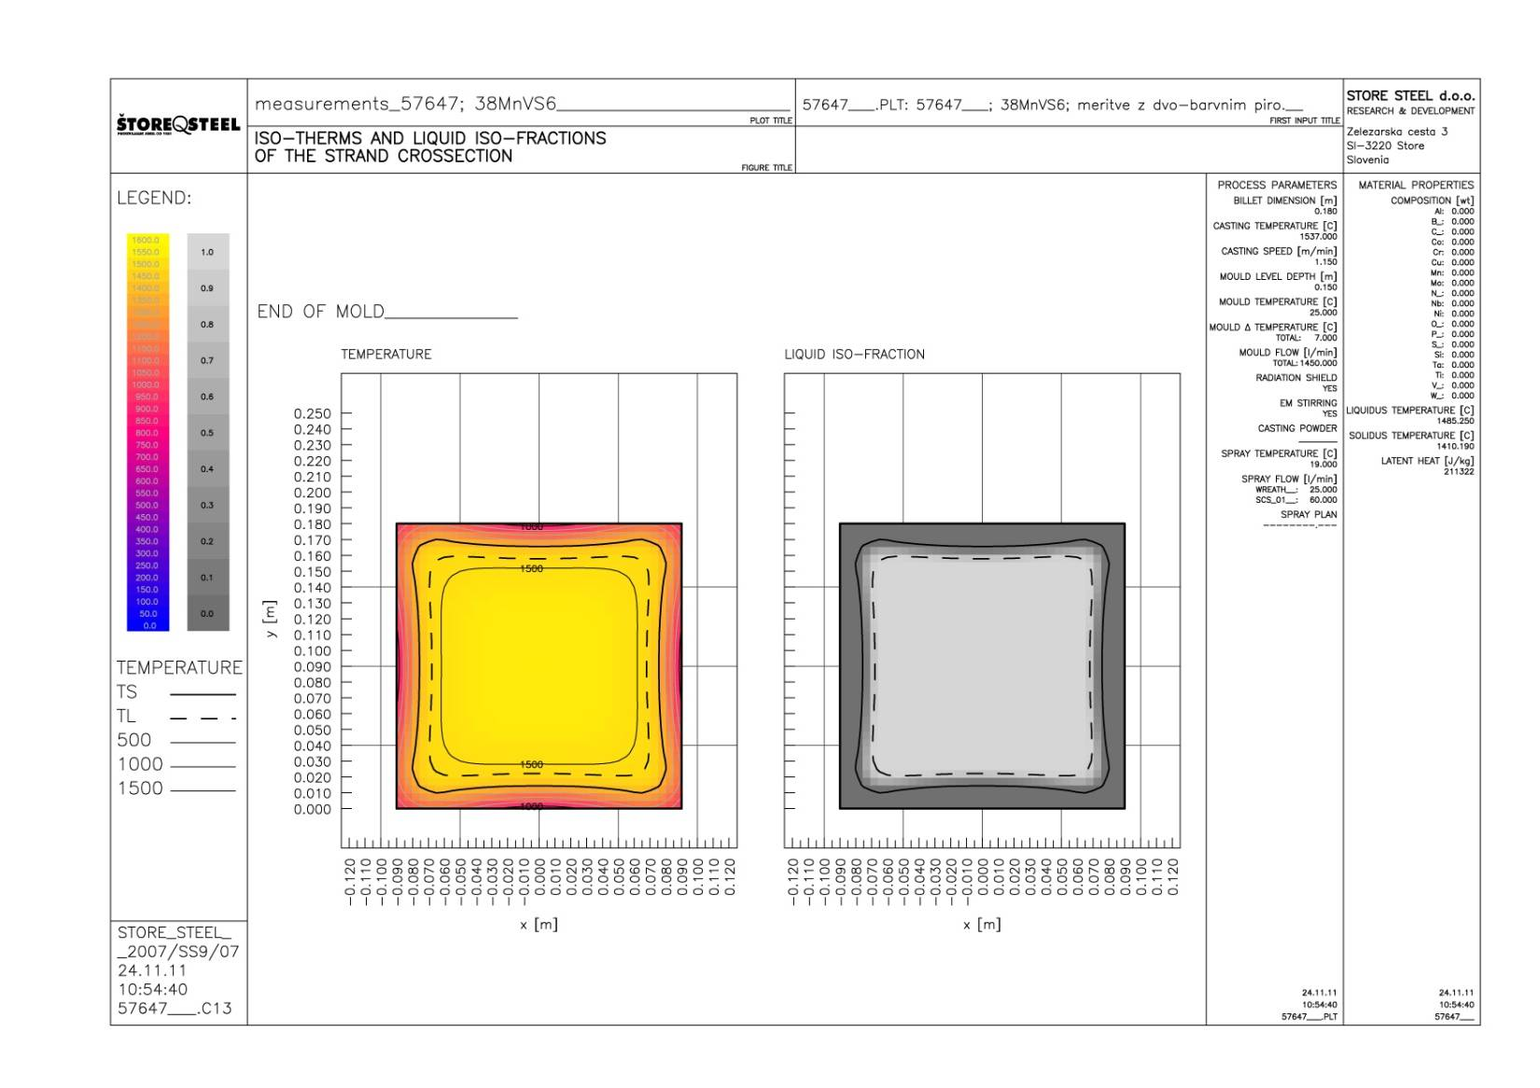

Example of CC Simulation

Slide 13
Artificial Neural Network

Slide 14
Artificial Neural Network - ANN
An information-processing system that has certain performance characteristic similar to biological neural networks
Have been developed as generalizations of mathematical models of human cognition
Information processing occurs at many simple elements called neurons
Signals are passed between neurons over connection links
Each link has an associated weight
Each neuron applies an activation function

Slide 15
ANN - Types
Feedforward NN
Feedforward backporpagation NN
Self organizing map (SOM)
Hopfield NN
Recurrent NN
Modular NN
…

Slide 16
ANN – Examples of Applications
Is an extremely interdisciplinary field
Signal processing
Suppressing noise on a telephone line
Control
Provide steering direction to a trailer truck attempting to back up to a loading dock
Pattern recognition
Recognition of handwritten characters
Medicine
Diagnosis and treatment
Speech production / recognition, business…
Notes:
Fundamentals of neural networks. Str. 7-11

Slide 17
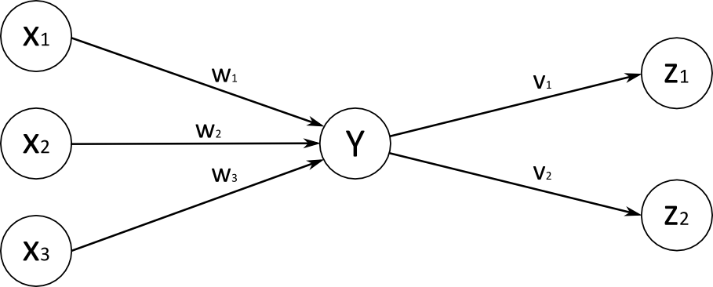
ANN - Characterization
Architecture - pattern of connections between the neurons
Training or learning – method of determining the weights on the connections
Activation function
Input
units
Hidden
units
Output
units
Notes:
Fundamentals of neural networks. Str. 3-5

Slide 18
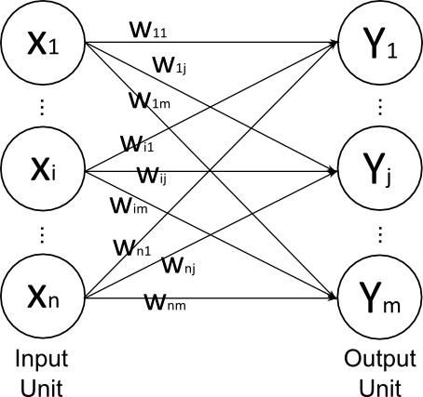
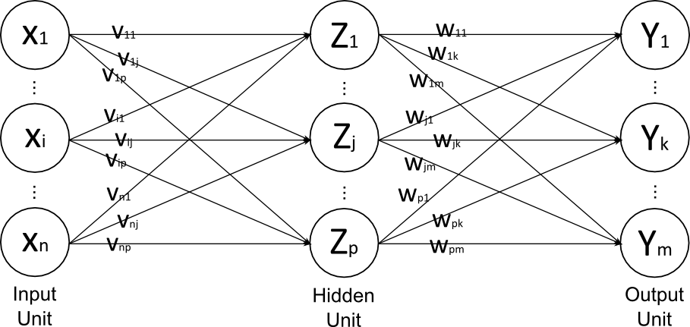
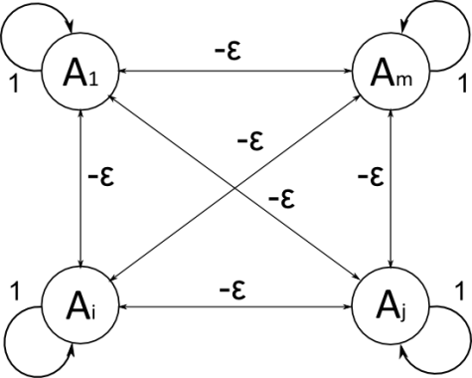
ANN - Architecture
The arrangement of neurons into layers and the connection patterns between layers
Single-layer net
Input and output units
Multi-layer net
Input, output and hidden units
Competitive layer
Notes:
Fundamentals of neural networks. Str.12-14

Slide 19
ANN – Training or Learning
Learning algorithms
Supervised learning
(error based)
Reinforcement learning
(output based)
Unsupervised learning
Stochastics
Error correction
Gradient descent
Hebbian
Competitive
Least mean square
Back propagation
Notes:
08-Neural network s str. 25
Supervised learning is based on input and output data. Learning process is based on comaparison on
Unsupervised learning is based on input data. The system learns on its own, by discovering the structural features in the inputs patterns.

Slide 20
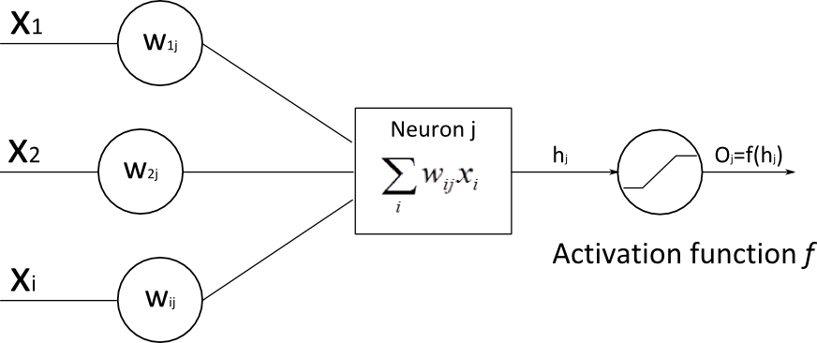
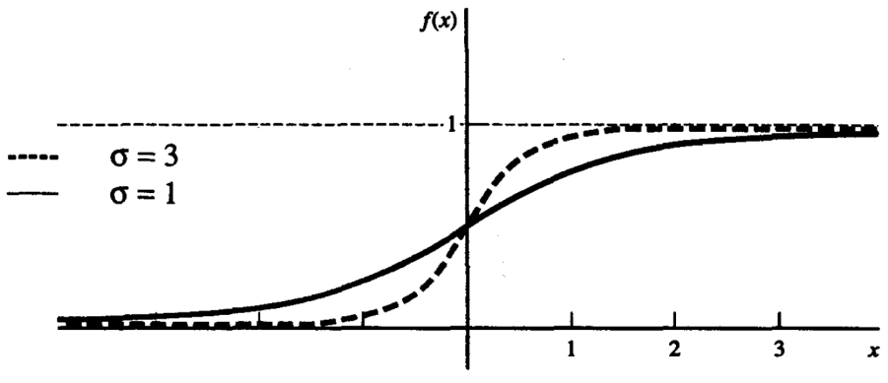
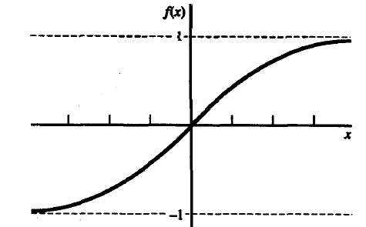
ANN – Activation Functions
Typically, the same activation function is used for all neurons in any particular level
Identity function
Binary step function
Binary sigmoid
Bipolar sigmoid
Hyperbolic tangent
Notes:
Fundamentals of neural networks. Str. 17-19

Slide 21
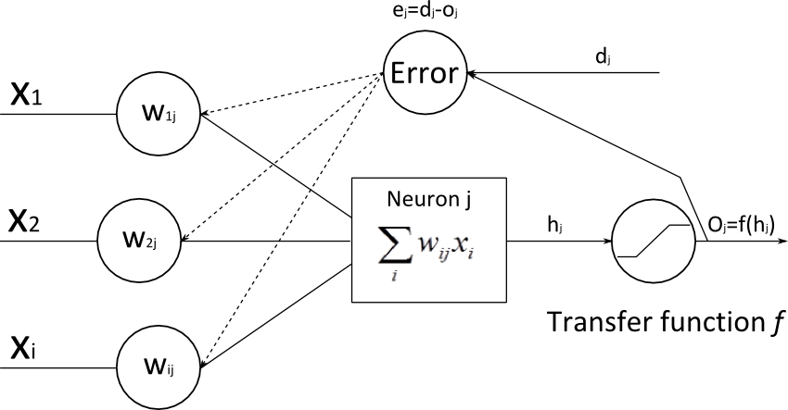
ANN – Feedforward Backpropagation
A gradient descent method to minimize the total squared error of the output
A backpropagation (multilayer, feedforward, trained by backpropagation) can be used to solve problems in many areas
The training involves three stages
The feedforward of the input training pattern
The calculation and backpropagation of the associated error
The adjustment of the weights
Update weights
Backpropagation
Feedforward

Slide 22
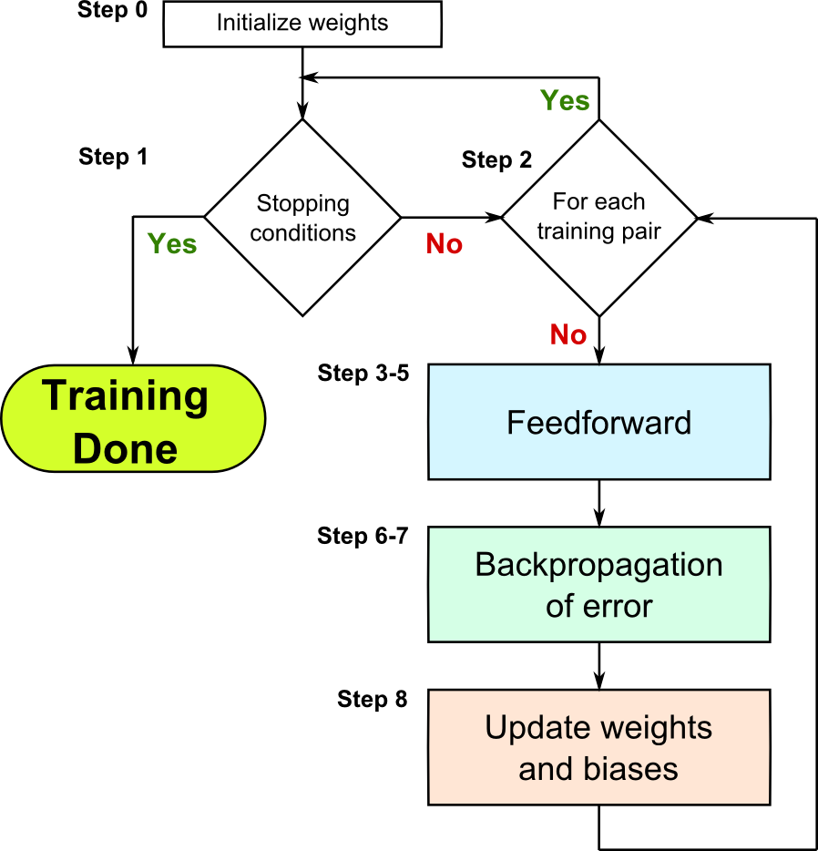
ANN –Backpropagation Algorithm

Slide 23
ANN –Backpropagation Algorithm
Feedforward
Step 3
Each input unit receives input signal and broadcasts the signal to all units in the layer above (hidden layer)
Step 4
Each hidden unit
sums its weighted input signals
applies its activation function
and sends this signals to all units in the layer above (output unit)
Step 5
Each output unit
sums its weighted input signals
and applies its activation function

Slide 24
ANN –Backpropagation Algorithm
Feedforward
Apply activation function
Apply activation function
Sums weighted IN signal
Input
Weights
X₁
Y₁
Z₁
X₂
Sums weighted IN signal
Z_{j}
X_{n}
Y_{k}
Weights

Slide 25
ANN –Backpropagation Algorithm
Backpropagation of errors
Step 6
Each output unit receives a target pattern
computes its error information term
calculates its weight correction term
calculates its bias correction term
and sends to units in the layer below
Step 7
Each hidden unit sums its delta inputs
calculates its error correction term
calculates its weight correction term
and calculates its bias correction term

Slide 26
ANN –Backpropagation Algorithm
Backpropagation of errors
Weight correction term
Bias correction
term
Delta inputs
Input
Weights
X₁
Y₁
Z₁
X₂
Error information term
Error information term
Z_{j}
X_{n}
Weight correction term
Y_{k}
Bias correction term
Weights
Output

Slide 27
ANN –Backpropagation Algorithm
Update weights and biases
Step 8
Each output unit updates its bias and weights
Each hidden unit updates its bias and weights

Slide 28
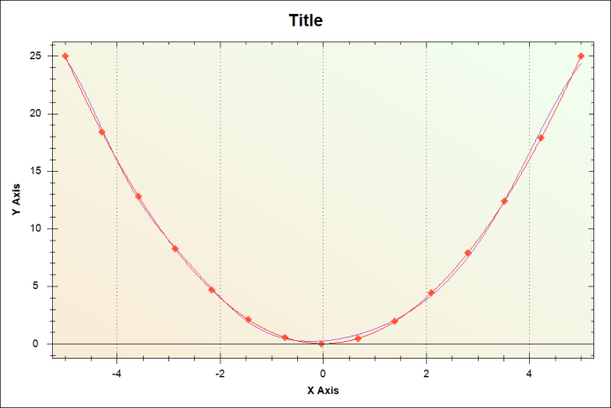
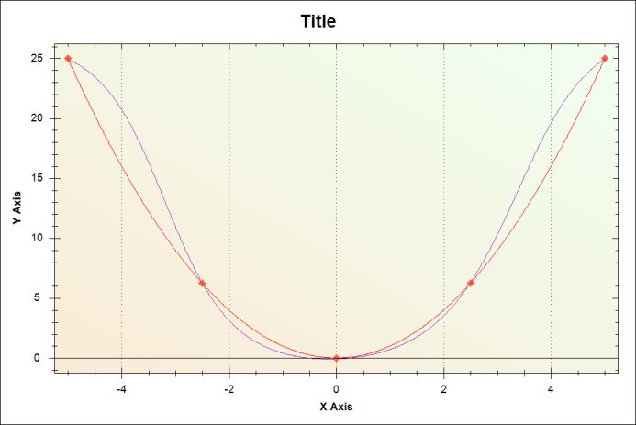
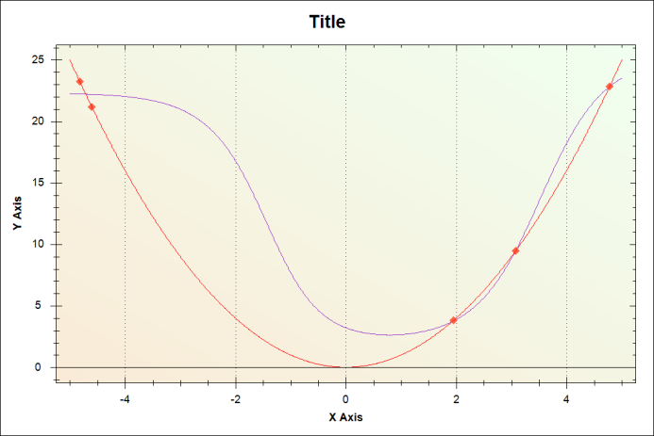
ANN – Training-Data
Training-data quality
Sufficient number of
training data pairs
Training data points distribution
Verification points selection

Slide 29
ANN – Calculation of response
After training, a backpropagation NN is using only the feedforward phase of the training algorithm
Step1
Initialize weights
Step2
For set activation of input unit
Step3
For
Step4
For

Slide 30
Modeling of continuous casting of steel by ANN

Slide 31
Physical Simulator Parameters
21 Input parameters
Charge number
Steel type
Concentration: Cr, Cu, Mn, Mo, Ni, Si, V, C, P, S
Billet dimension
Casting temperature
Casting speed
Delta temperature
Cooling flow rate in the mold
Cooling water temperature in sprays
Cooling flow rate in wreath spray system
Cooling flow rate in 1st spray system
21 Output parameters
ML
DS
T

Slide 32

Generating Parameters & Outputs
JMatPro
Training Data Generator
Node 1
Node 2
Node i
. . .
Input parametrs
Input parametrs
Input parametrs
Physical symulator
Physical symulator
. . .
Physical symulator
Training data file

Slide 33
Casting Parameters & Outputs
ID | Name & units | Description | Range in the training set
1 | Tcast [ºC] | Casting temperature | 1515 - 1562
2 | v [m/min] | Casting speed | 1.03 - 1.86
3 | DTmold [ºC] | Temperature difference of cooling water in the mold | 5 - 10
4 | Qmold [l/min] | Cooling flow rate in the mold | 1050 - 1446
5 | Qwreath [l/min] | Cooling flow rate in wreath spray system | 10 - 39
6 | Qsistem1 [l/min] | Cooling flow rate in 1st spray system | 28 - 75
ID | Name & units | Description & units | Range in the training set
1 | ML [m] | Metallurgical length | 8.6399 - 12.54
2 | DS [m] | Shell thickness at the end of the mold | 0.0058875 - 0.0210225
3 | T [ºC] | Billet surface temperature at straightening start position | 1064.5 - 1163.5

Slide 34
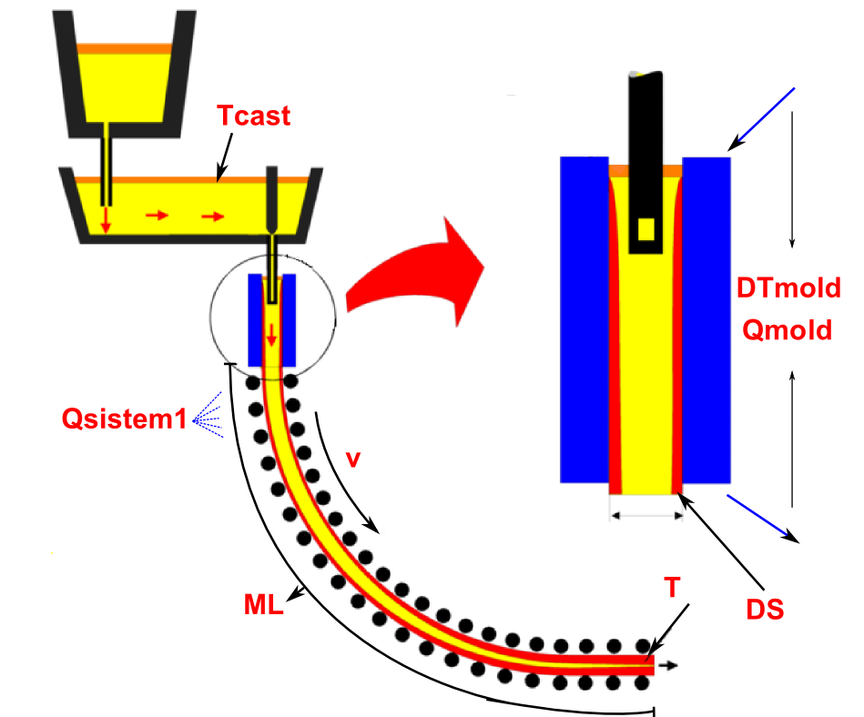
Casting Parameters & Outputs

Slide 35
Training the ANN
NeuronDotNet open source library
200000 total IO pairs
100000 training IO pairs
100000 verification IO pairs
Settings for ANN
Epochs 50000
Hidden layers 1
Neurons in hidden layer 25
Learning rate = 0.3
Momentum = 0.6

Slide 36
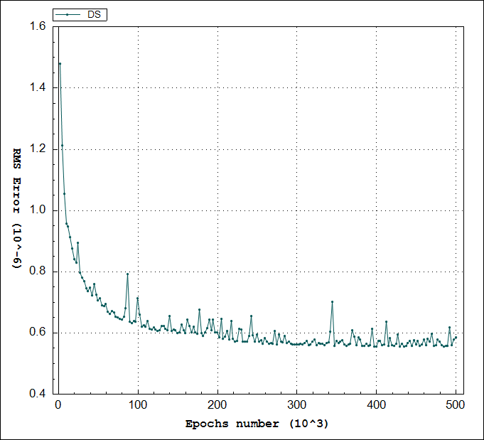
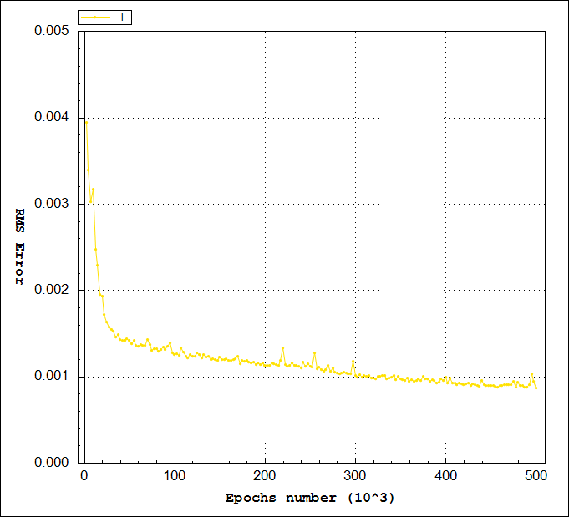
Training the ANN
RMS errors during training

Slide 37
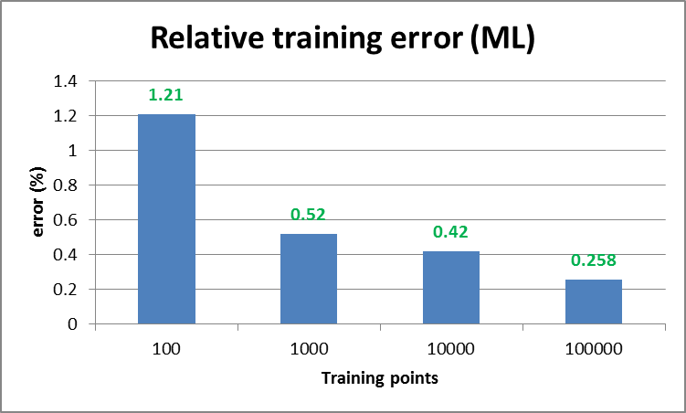
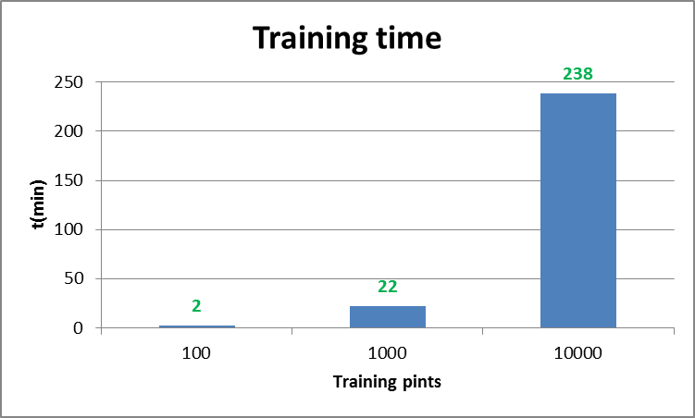
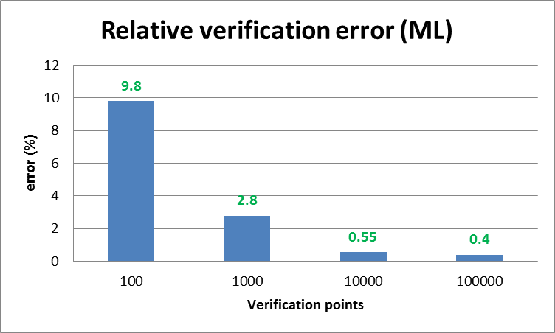
Studies
Relations between training time, training data and errors

Slide 38
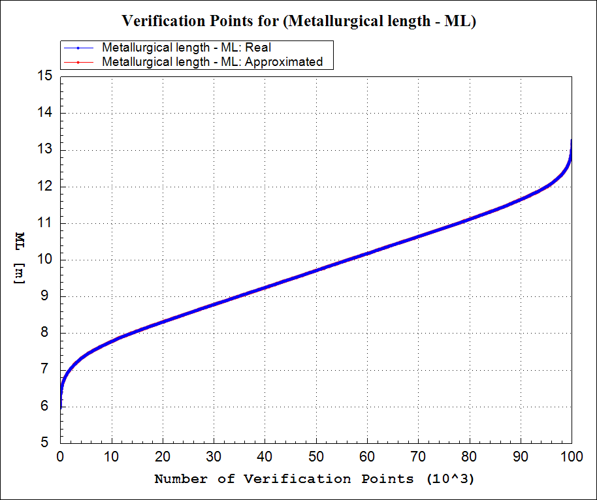
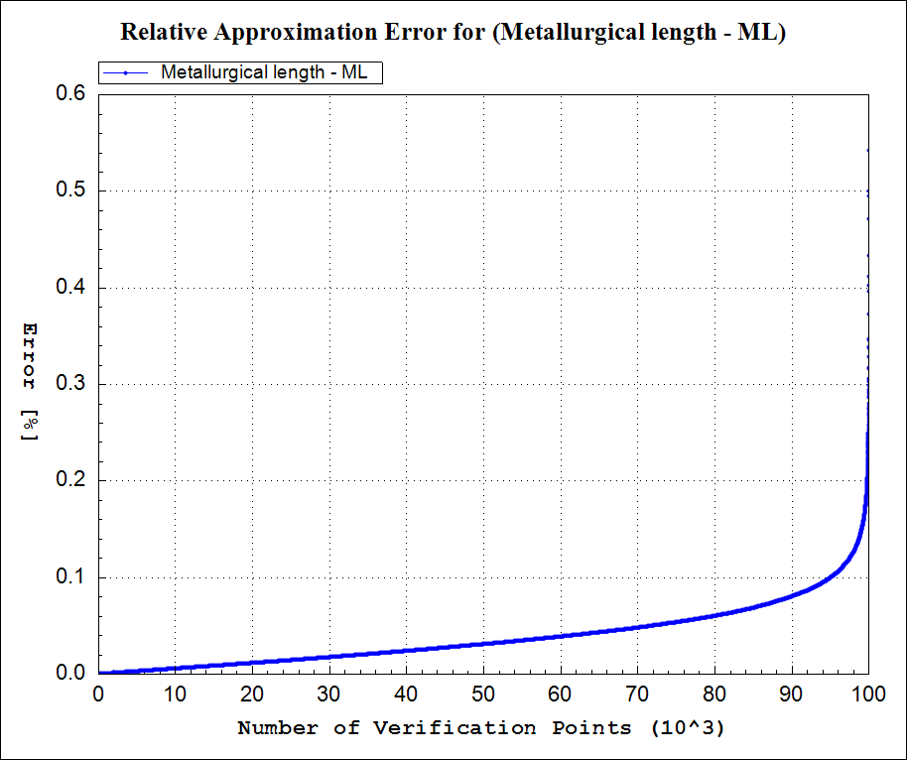
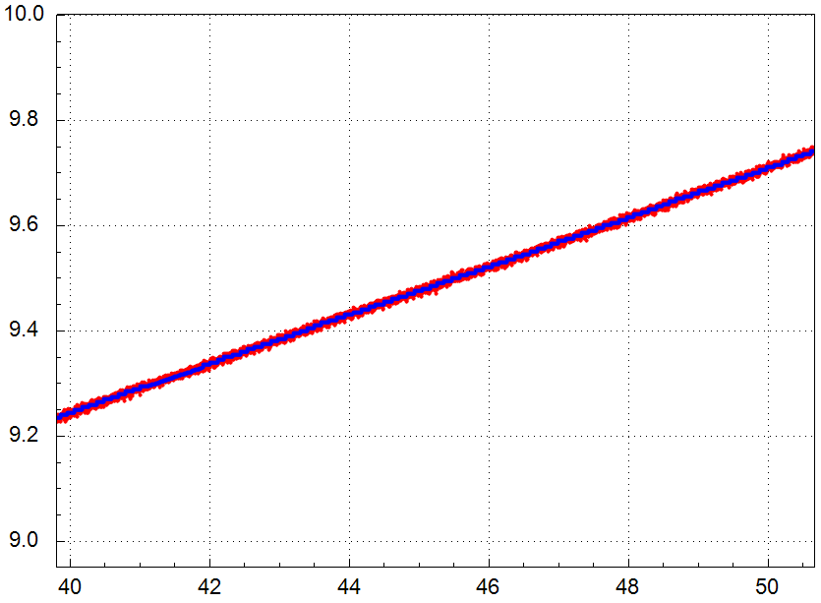
Study of Errors
Relative errors in verification points

Slide 39
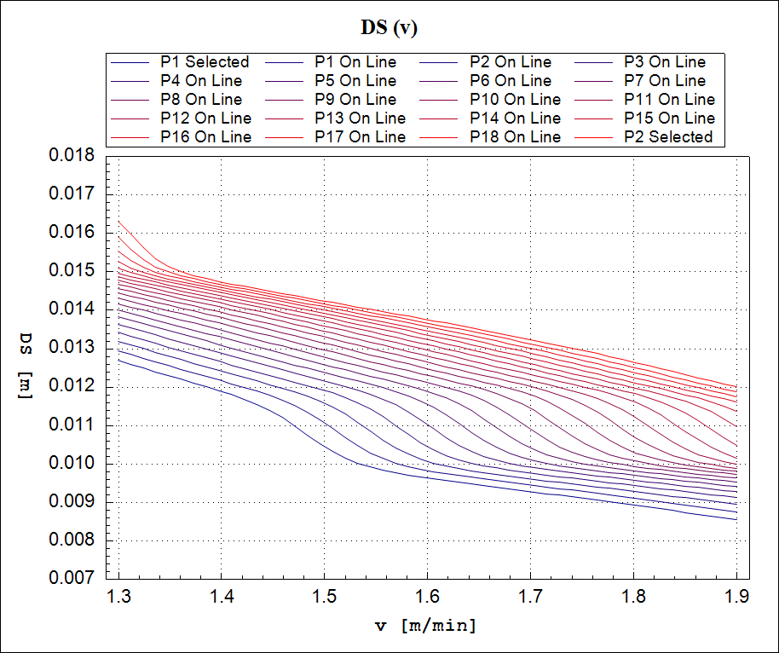
Parametric Studies
Response around Points on a Line Between Two Points

Slide 40
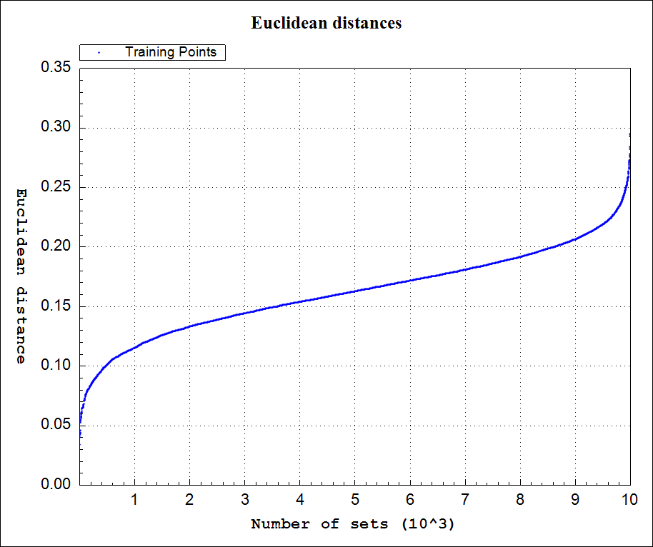
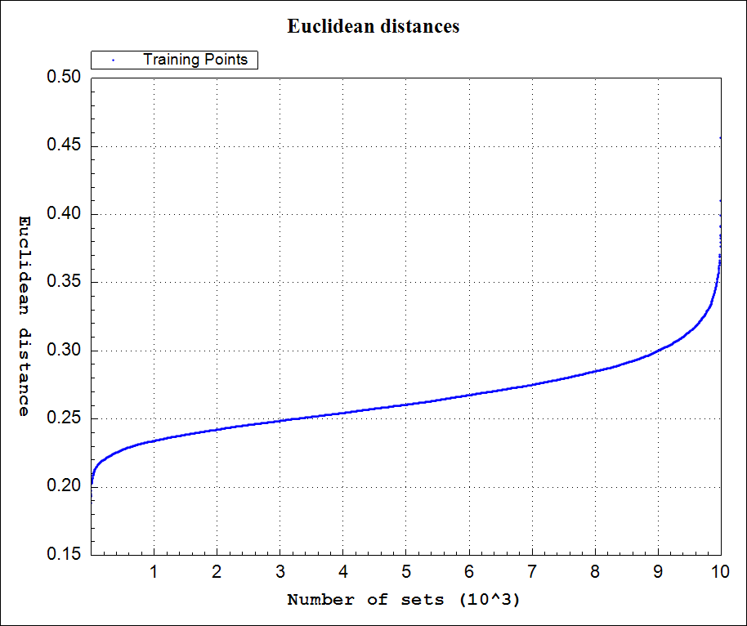
Studiy: Uniformity of Training Points Distribution
Euclidean distances to the N-th point
Closest point
9-th closest point

Slide 41
Conclusions and future work
Dedicated SW framework was developed
Studies to examine the accuracy of ANN based on physical model
ANN approximation is much faster than physical simulation
Complementing physical models with ANNs
Replacing physical models with ANNs
Upgrading of the ANN model for continuous casting with the model of the whole production chain
Development of new methods for checking the quality of training-data
Notes:
Conclusion in the article

Slide 42
References
ŠARLER, Božidar, VERTNIK, Robert, ŠALETIĆ, Simo, MANOJLOVIĆ, Gojko, CESAR, Janko. Application of continuous casting simulation at Štore Steel. Berg- Huettenmaenn. Monatsh., 2005, jg. 150, hft. 9, str. 300-306. [COBISS.SI-ID 418811]
Fausett L.. Fundamentals of neural networks: architectures, algorithms and applications. . Englewood Cliffs, NJ: Prentice-Hall International, 1994.
I. Grešovnik, T. Kodelja, R. Vertnik and B. Šarler: A software Framework for Optimization Parameters in Material Production. Applied Mechanics and Materials, Vols. 101-102, pp. 838-841. Trans Tech Publications, Switzerland, 2012.
I. Grešovnik: IGLib.NET library, http://www2.arnes.si/~ljc3m2/igor/iglib/.
Acknowledements
Prof.dr.Božidar Šarler, dr. Igor Grešovnik, dr. Robert Vertnik
Notes:
Conclusion in the article

Slide 43
Thank you!

